Slide 1
Reviewr
Group project Algorithms and Datastructures & Databasesystems
Michiel Vanhecke
02310465
Norah Dewulf
02310142
Michelle Mannaerts
02308405
Jasper Geens
02308132

Slide 2
Publish Research
  Researchers upload and showcase their work on a dedicated platform.
Discover Innovation
  Companies easily search, explore, and access relevant research.
Smart Matching
  Personalized paper recommendations based on company interests.
Measure Impact
  Clear insights into paper views and engagement.
REVIEWR
Connecting cutting-edge research with the companies that need it
REVIEWR is a smart submission and discovery platform that increases research visibility and helps companies quickly find papers aligned with their research interests.
Researchers publish → REVIEWR matches → Companies discover

Slide 3
Smart Matching Algorithm
Relevant research. Automatically
50%
Paper Subject
Match
35%
Author Research
Field
Relevance Score
0 – 100 %
10%
Researcher
Experience
30%
Repeat Interest
Bonus
Matching Logic
Substring matching
Word overlap
Case-insensitive

Slide 4
AGILE METHOD
Sprint 1: First version with basic features
  Feedback (12/11): add a recommendation system + reviews
Sprint 2: Recommendation algorithm added
Sprint 3: Reviews added + UI
  Feedback (17/12): Sufficient for MVP, no further feedback
  In between sprints: further feedback from Thomas Derave

Slide 5
MVP, what now?
Platform evolution
Author & company profiles
Blog posts & private messaging
Notification centre
Smarter matching
Further refinement of recommendation algorithm

Slide 6
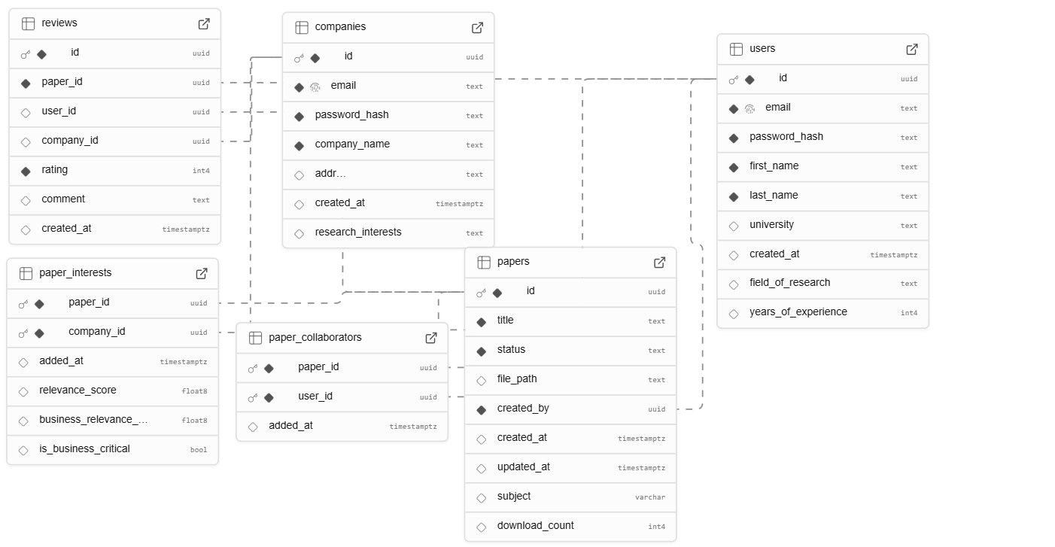
Database

Slide 7
Code overview
app/app/
├── app.py → Main Flask app
├── models.py → Database models
├── routes/
│ ├── auth.py → Login/Register
│ ├── papers.py → Paper CRUD + recommendations
│ ├── interests.py → Company interests
│ └── collaborators.py → Paper collaborators
├── templates/ → HTML pages
└── static/ → Files that are sent directly to the browser

Slide 8

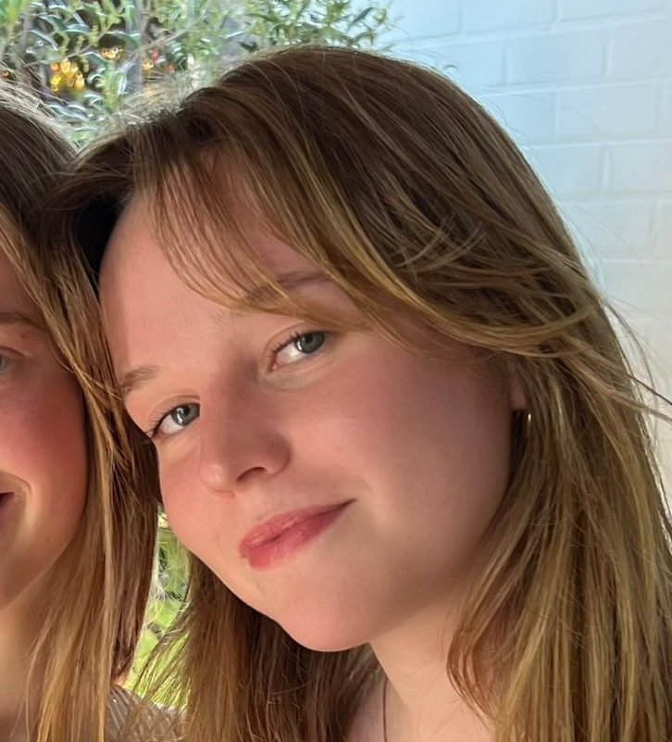
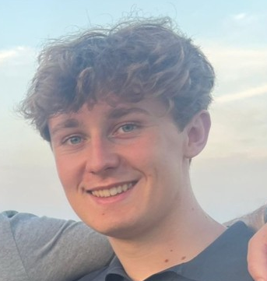
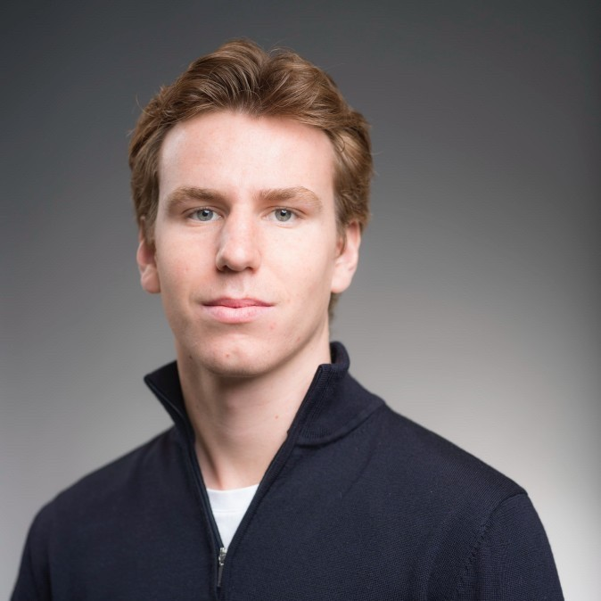
Michelle Mannaerts – 3rd bachelor HIR
Michelle.Mannaerts@ugent.be
Norah Dewulf – 3rd bachelor HIR
Norah.Dewulf@ugent.be
Michiel Vanhecke – 3rd bachelor HIR
Michiel.Vanhecke@ugent.be
Jasper Geens – 3rd bachelor HIR
Jasper.Geens@ugent.be

